Slide 1


AI Driven Health Monitoring App
What if your smartwatch could save your life?
Jayanth Apagundi
Priyadarshine Kumar
Swathi Priya Pasumarthy
Jayasurya Pazhani

Slide 2
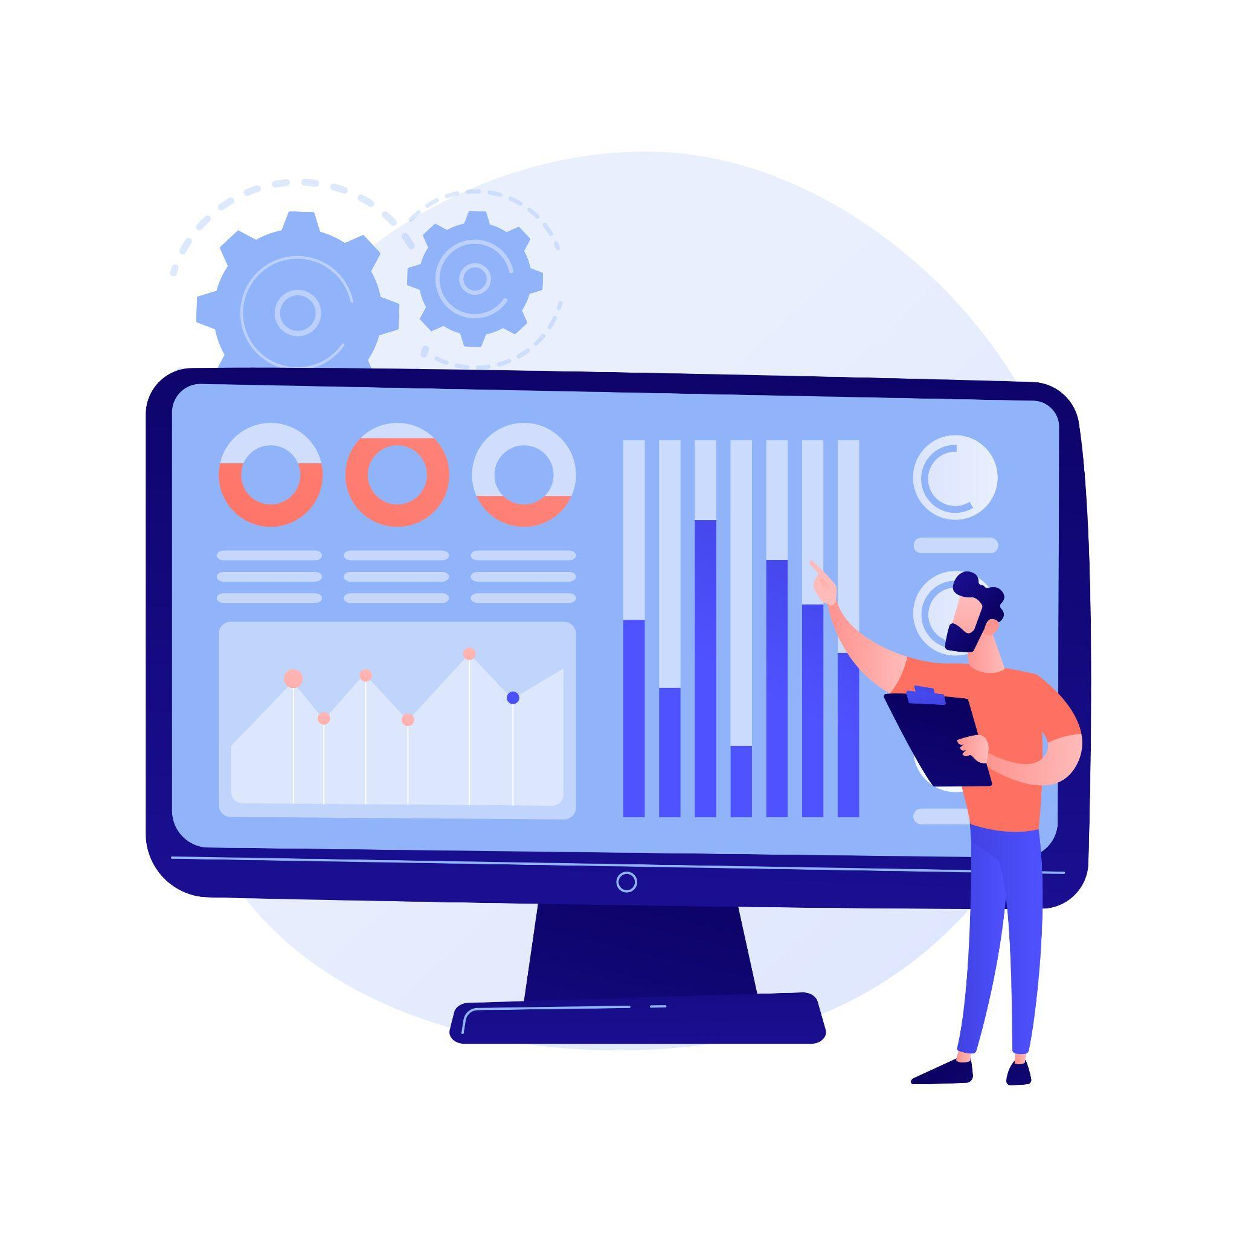
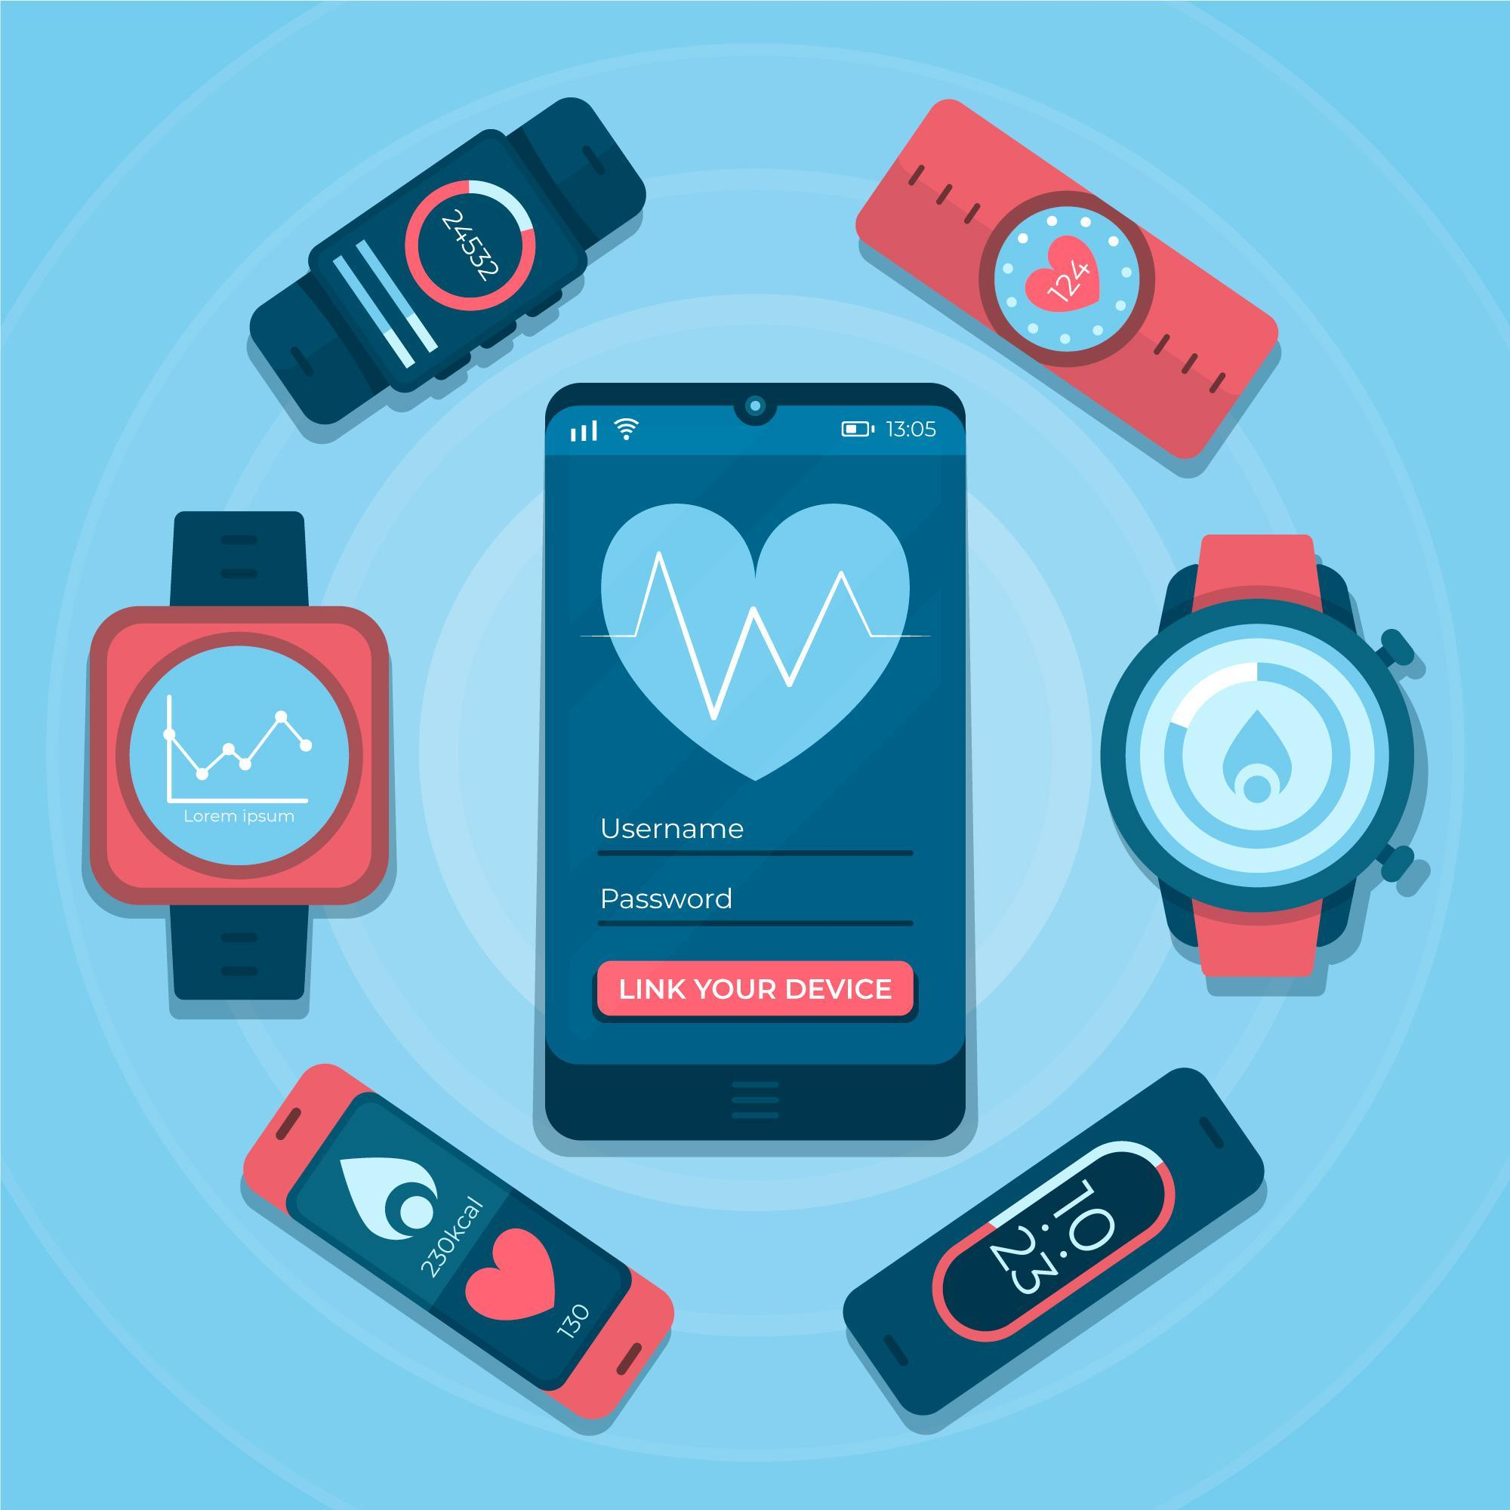
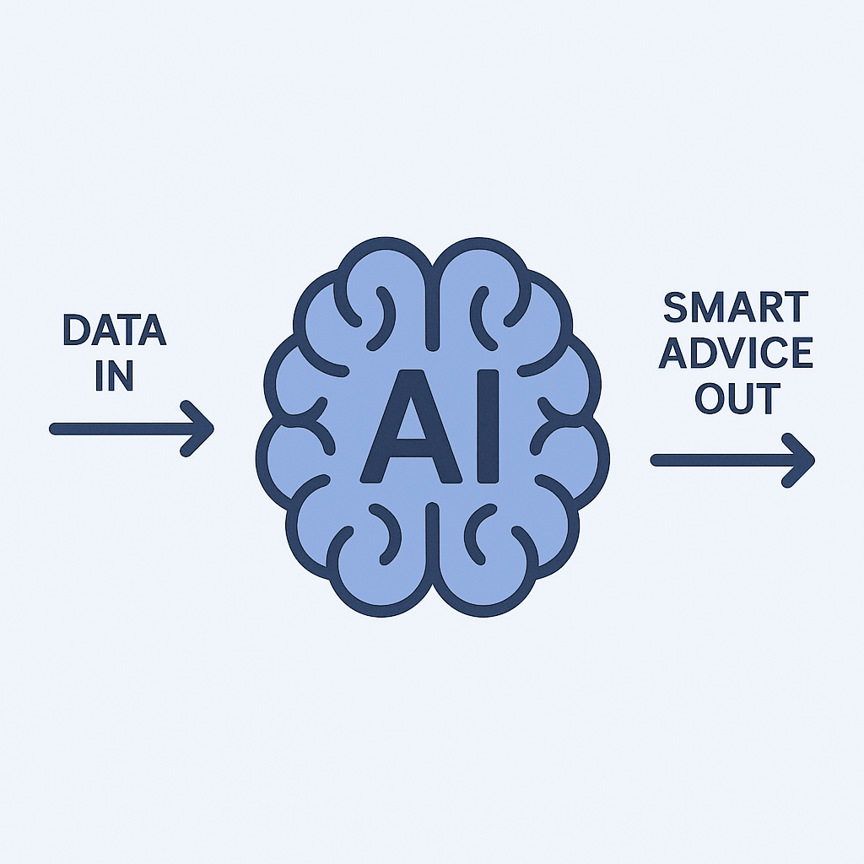
Opening Overview – Why This Matters
The Challenge:
Chronic diseases are on the rise.
People lack real-time insights into their own health.
Preventable conditions go unnoticed until it’s too late.
Our Solution:
AI-Powered Health Monitoring App
Tracks vital signs, detects anomalies, and gives smart health advice.
Helps users take action before problems escalate.

Slide 3

Global Digital Health Market Trends
Market Size & Growth
• Valued at $96.5B in 2020, projected to reach $220B by 2026
• Wearable tech market to surpass $70B by 2026
Adoption Trends
• 72% of consumers interested in AI-driven health tracking
• 80% of healthcare providers planning AI integration
Key Insight
Massive growth and high interest create a prime opportunity for AI-powered health solutions.
Notes:
"Let’s dive into why the market is ready and waiting for our AI-Driven Health Monitoring App.
We're stepping into a booming digital health market, projected to soar past $220 billion by 2026. With over 72% of consumers interested in AI-based personalized health tracking, and 80% of healthcare providers gearing up to adopt AI systems, the timing couldn’t be better.
Now, here’s our edge—unlike competitors like Apple or Fitbit, we offer AI-powered stress and fatigue detection, emotion tracking via facial analysis, and no subscription model. That’s right—premium features at a one-time cost.

Slide 4
Understanding Our Users
🎯 Primary Target Audience
• Health-conscious individuals, Patients with chronic illnesses, Elderly individuals, Healthcare professionals and caregivers.
👥 Secondary Target Audience
• Corporate Employees and Remote Workers, Students and Young Adults, Parents and Family Caregivers, Insurance and Healthcare Providers, Wellness and Lifestyle Enthusiasts.
🧬 Demographics: Age 18–65+, urban/suburban, middle-to-high income
Notes:
Our primary users? Health-conscious individuals, people managing chronic conditions, elderly users, and even fitness fanatics—all eager for real-time insights. But we go beyond: corporate professionals, students battling stress, and even insurance companies are part of our secondary market, making our solution truly inclusive.

Slide 5
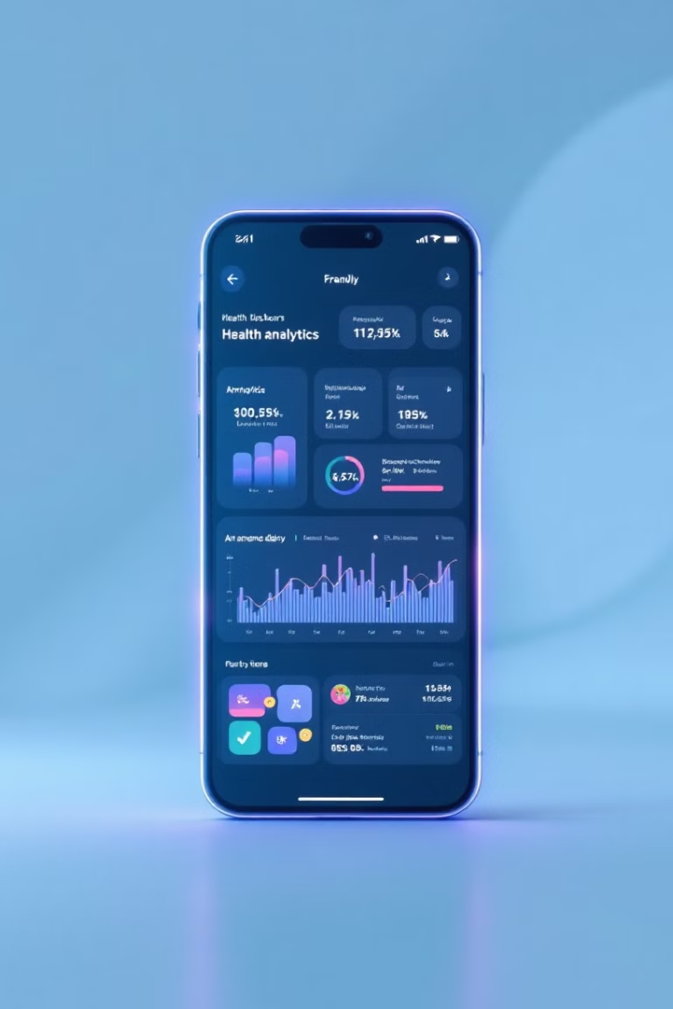




AI-Powered Health Monitoring App
Track Vital Signs
Monitors physical and mental health indicators in real-time.
Analyze Patterns
Uses advanced AI models to identify trends and anomalies.
Generate Insights
Delivers personalized health recommendations and alerts.
Secure Data
Protects information with encrypted cloud storage.
Our solution empowers proactive health management. Users can make informed decisions before problems arise.
Notes:
"Let me walk you through our game-changing solution.
We’re building an AI-Driven Health Monitoring App that goes far beyond step counts and heart rates. This is intelligent, proactive healthcare in your pocket. By combining data from smartwatches with advanced machine learning models like Random Forest, SVM, and CNN, our app doesn’t just track health—it understands it.
From detecting stress through voice and facial analysis to predicting cardiovascular risks in real time, our app delivers personalized, real-time recommendations that empower users to take preventive action—before issues become emergencies.
It’s secure, compliant with HIPAA and GDPR, and built on a scalable tech stack including React Native, Node.js, and cloud platforms. We’re integrating emergency alerts, gamified wellness goals, and even sleep, hydration, and mood tracking.
Ultimately, this is more than an app—it’s a 24/7 AI health companion, built to transform passive wearables into active lifesavers."

Slide 6
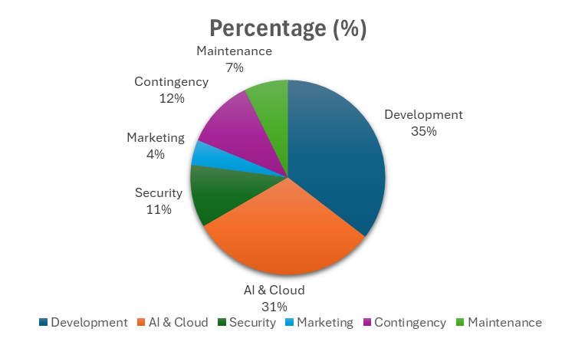
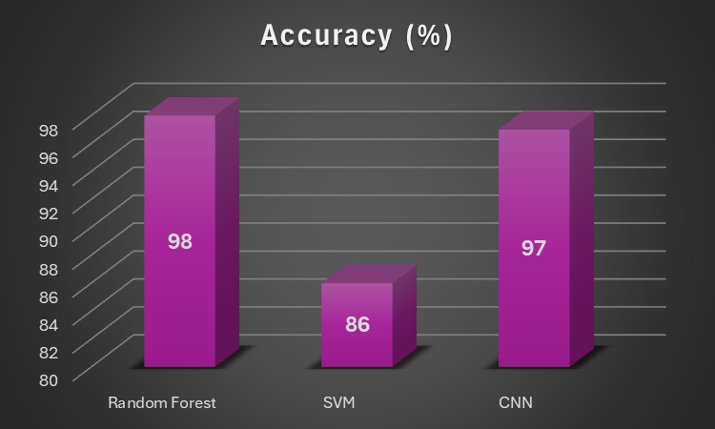
Is This Solution Realistic? Yes — and Here’s Why.
🛠️ Technical Feasibility:
Technologies - React Native, Node.js, TensorFlow, and PostgreSQL.
Seamless integration with wearables (e.g., Apple Watch, Fitbit).
Tested with high accuracy:
97% for mood detection
93% AUC for heart disease prediction
98% accuracy for activity recognition
⚙️ Operational Feasibility
Designed with cross-platform access, voice control, and senior-friendly UI.
Complies with HIPAA and GDPR standards.
Emergency alert system integrated for at-risk users.
💵 Economic Feasibility
Total initial cost: $147,000
Expected revenue: $3M in Year 1
ROI: Break-even in ~9 months
No subscription model = broader user adoption.
Low cost, high-impact solution with sustainable growth.

Slide 7
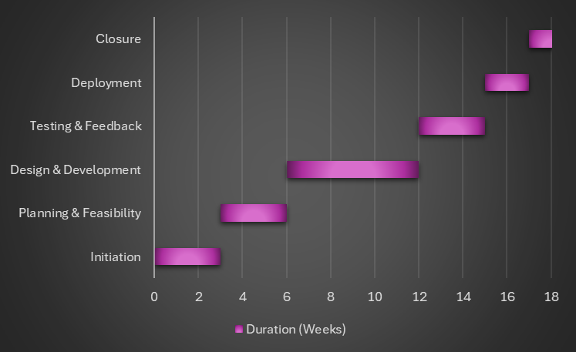
Roadmap to Success
A Clear Path to Delivery:
🔧 Duration: 18 Weeks
🪜 Phases & Milestones:
Initiation (Weeks 1–3) ✔ Define scope, team, and goals
Planning & Feasibility (Weeks 4–6) ✔ Market analysis, feasibility report, budget
Design & Development (Weeks 7–12) ✔ Build app, train AI models, integrate wearables
Testing & Feedback (Weeks 13–15) ✔ QA, UAT, usability testing
Deployment (Weeks 16–17) ✔ Final testing, launch & performance validation
Closure (Week 18) ✔ Documentation, lessons learned, handoff

Slide 8
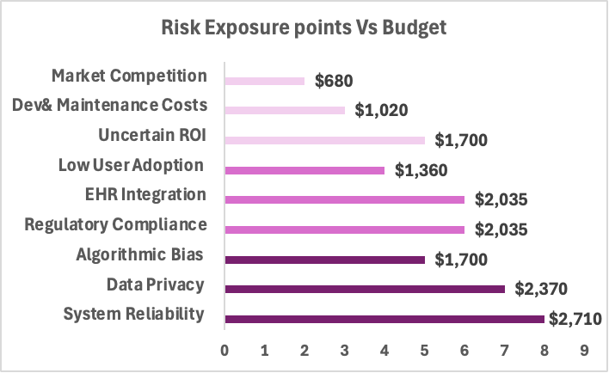
Risk Assessment & Mitigation
Risk Identification
Impact Analysis & Assessment
Economic
Operational
Technical
Total Risk Exposure Points are evaluated via likelihood of occurrence and Impact level.
Budget is allocated in proportionate to Risk Exposure Points.
Contingency Plan
Risk Mitigation
Maintain backup AI algorithms and manual override options
Create and test an incident response plan for data breaches
Include alternative integration options to prevent disruptions
Prioritize essential features and reserve budget for unexpected costs
Establish continuous monitoring and quality assurance protocols
Implement data encryption, access control, and regular security audits
Collaborate with healthcare IT teams for smooth integration
Focus on unique features and user experience to stay competitive
Use agile project management to detect and resolve issues early
Dollar value of Risk = (Risk Exposure Points for Risk)/
Total Risk Exposure Points
*
Total Contingency Fund

Slide 9
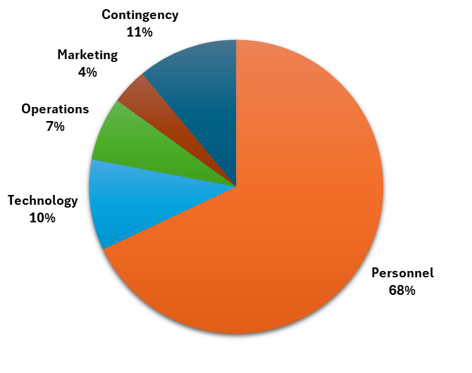
How the Budget Supports a High-Impact, Low-Risk Solution
Budget Breakdown & Allocation:
Marketing & Outreach – $6,000
Beta Program, Ads, User Acquisition
Personnel Costs – $100,000
Backend Developers (2): $18,000
Frontend Developers (2): $16,000
AI Engineers (2): $20,000
Data Scientist: $10,000
ML Engineer: $11,000
QA Engineers (2): $10,000
Project Manager: $15,000
Operational Costs – $10,000
UI/UX Design: $2,000
LMS/System Integration: $3,000
Accessibility & Compliance Features: $5,000
Technology Costs – $15,000
AI Frameworks (TensorFlow, PyTorch): $5,000
Cloud Services (AWS, GCP): $3,000
Development Tools & Data Processing: $7,000
Contingency Budget – $16,000
AI model retraining: $5,000
Infrastructure scaling: $5,000
Security & compliance updates: $6,000 - Covers risks such as tech failure, new regulations, or cost overruns.

Slide 10

Conclusion
By addressing real-world health gaps, validating market needs, planning smart, and mitigating risks — we pave the way for a robust AI-Driven Health Monitoring App that’s practical, scalable, and impactful.
From vision to viability, every step supports delivering a smarter, healthier future through AI.
Any questions?
We are ready to innovate. Are you ready to explore?

Slide 11
THANK YOU

